Slide 1
CSC435: Web Programming Lecture 1: the internet and the web
Bei Xiao
American University
Jan 15, 2019

Slide 2
Course Info
Instructor: Prof. Xiao, bxiao@american.edu
Office: Don Myers Room 110
Office hour: Tuesday, 3-4pm, Friday, 3-4pm
Class time: Jan 15- April 30th
Prerequisite: Intro to Programming (CSC 280)
Course website:
https://github.com/fruittree/CSC435WebProgramming

Slide 3
About Your Professor
Prof. Bei Xiao (Professor of Computer Science):
B.S. Tsinghua University, PhD University of Pennsylvania, Postdoc MIT.
https://sites.google.com/site/beixiao/
Research area: Human and Computer Vision. Computer Graphics.
Specialty: Material Perception, Multisensory perception, Physical-realistic rendering.
Preferred language: Python, MATLAB, JavaScript.
Intro to programming (CSC 280 last semester),
Computer Vision (CSC476, Every year),
Web Programming (This semester)
Computer graphics (near future)

Slide 4
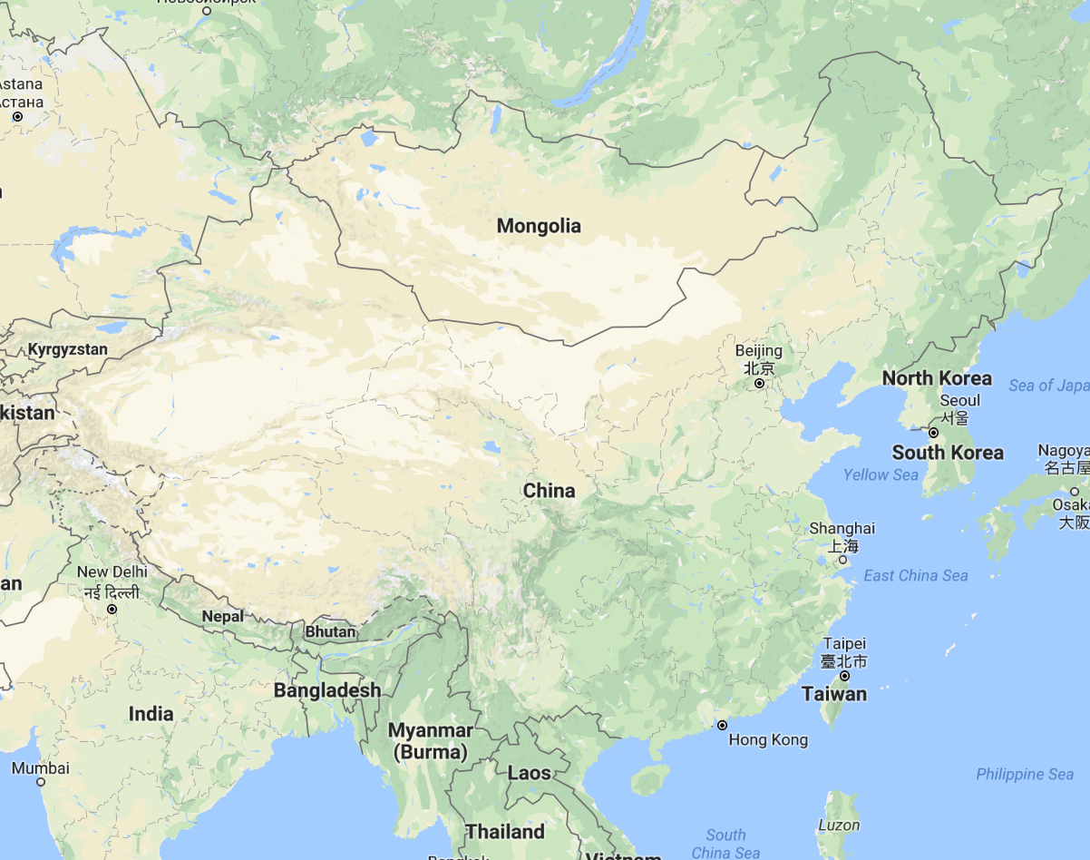
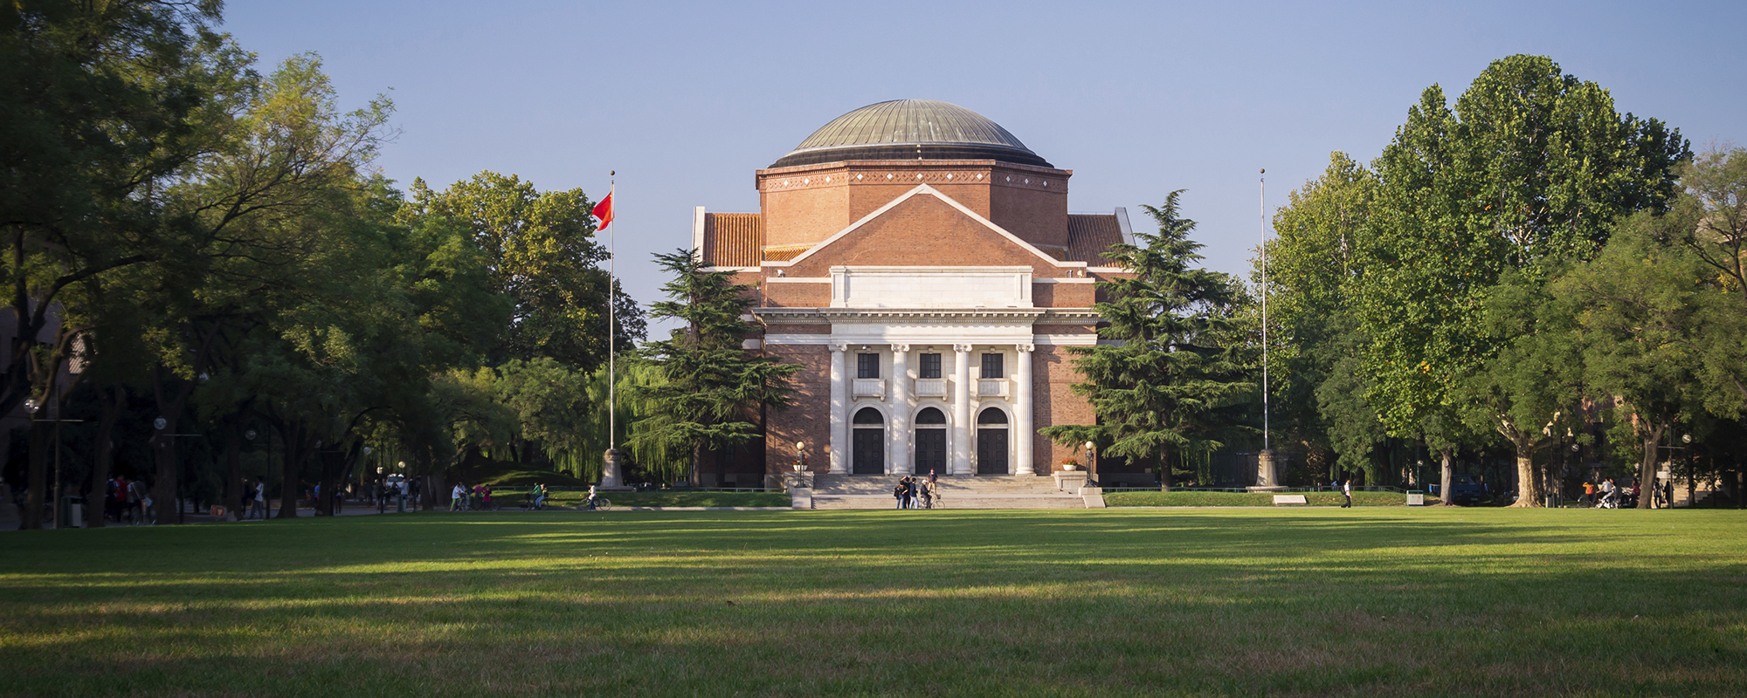
A bit about me
College:
Tsinghua University
Beijing, China
Degree: Chemistry

Slide 5
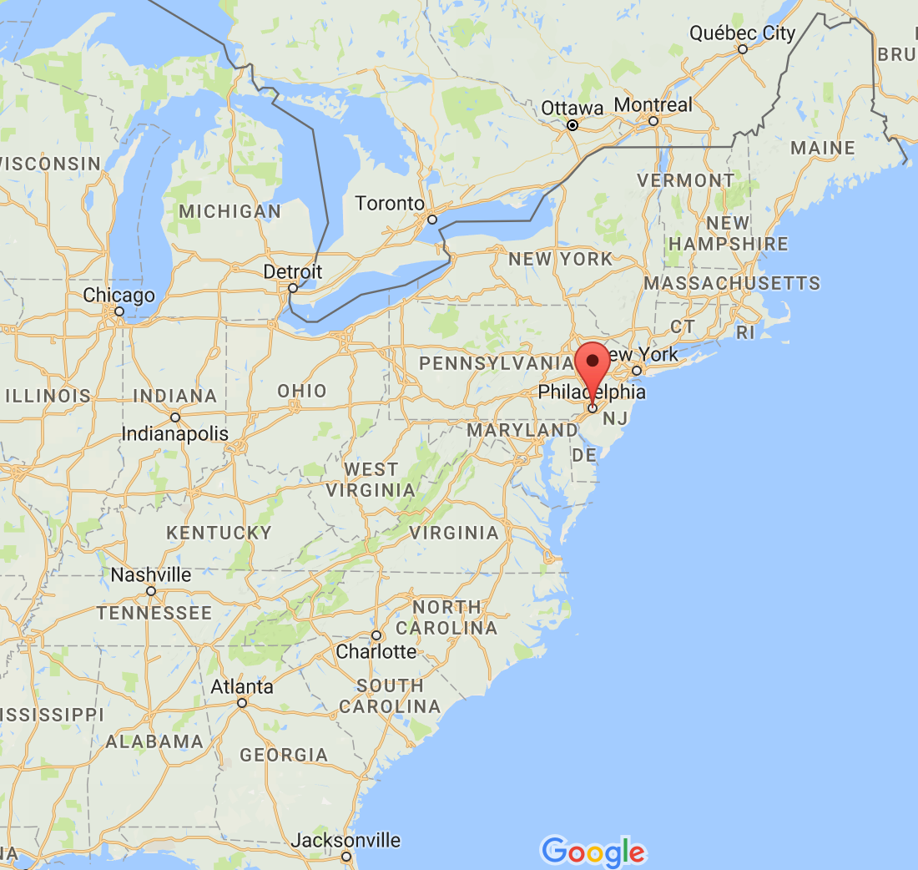
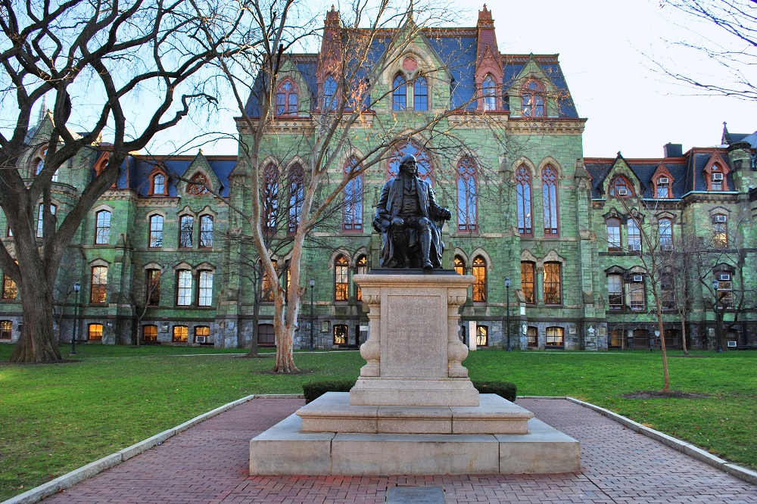
A bit about me
Graduate School:
University of Pennsylvania
Philadelphia, PA
Degree: Computational neuroscience

Slide 6
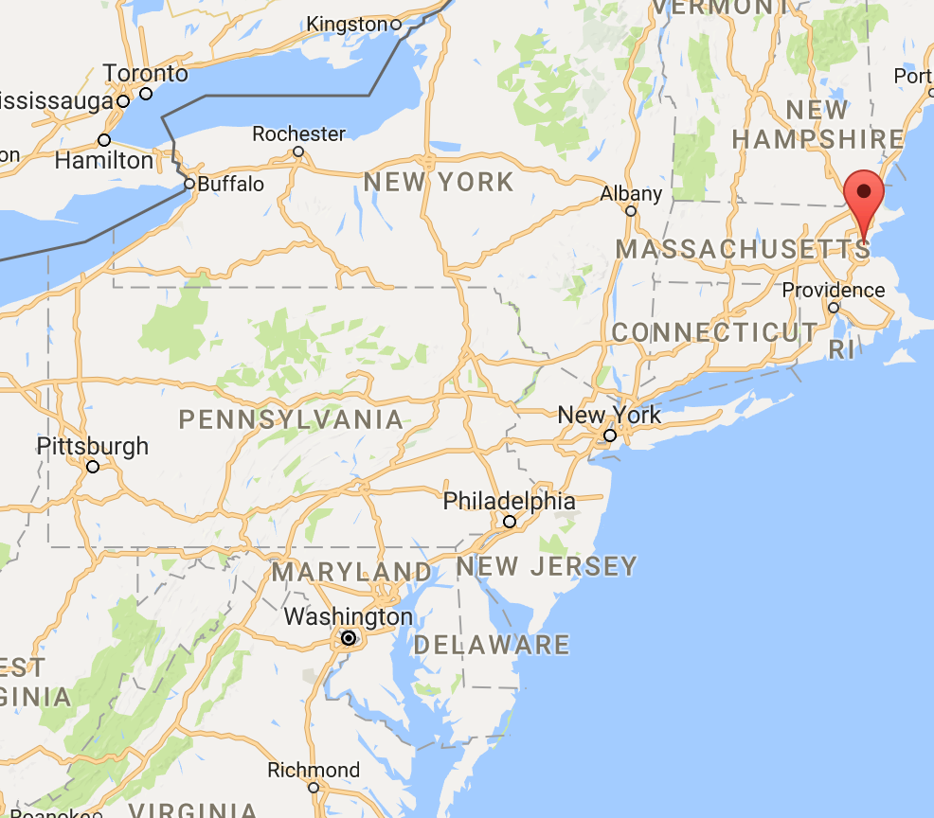
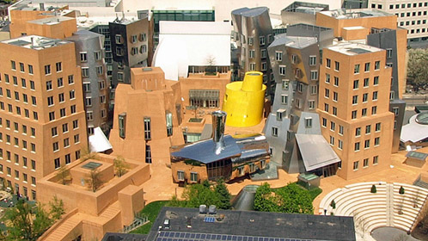
A bit about me
Postdoctoral Fellowship:
MIT
Cambridge, MA
Computer Vision and Human Perception

Slide 7
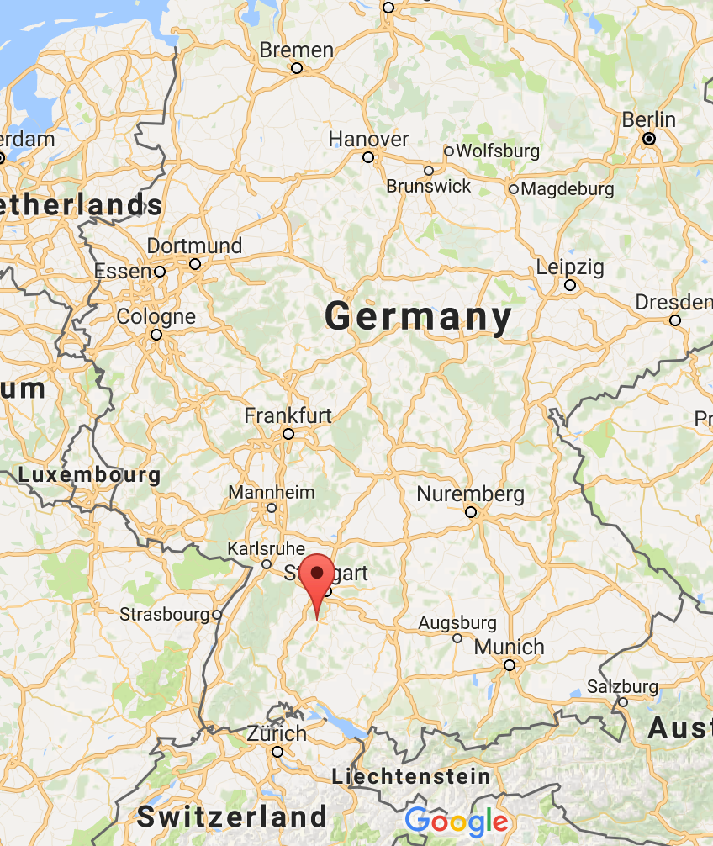
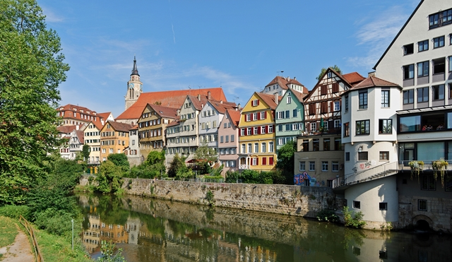
A bit about me
Summer Research2018
University of Tuebingen
Tubeinge, Germahy
Human Perception
Deep Learning
Machine Vision

Slide 8



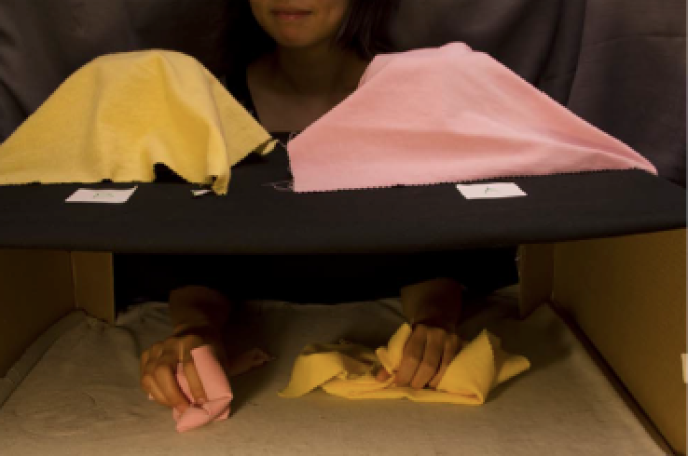
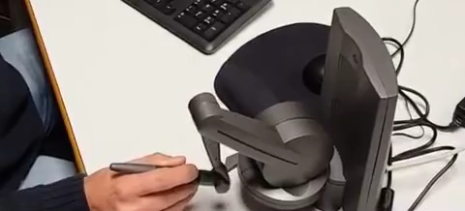
My research: vision and graphics
Machine Inference of material properties of cloth
Rendering and perception of translucent
materials
Visual and tactile material categorization
Tactile perception in VR

Slide 9
This class is about
Foundation of The Internet.
How the Internet works
How to make web pages that is interactive.
How web page works.

Slide 10
This class is NOT about
How to make website pretty and stylish
How to make mobile apps
How to make website user friendly
How to display and visualize data
If you wish to learn these things, take courses in graphic design program and DataVis calss from Alex Godwin

Slide 11
Promises
Web programming is in real-time is hard and messy.
I won’t know the answers to lots of questions, and I will google things in front of you.
I will fix my terrible code in front of you.

Slide 12
Grading
60% individual assignments (approximately 5-6 projects)
10% Mid-term exam (open-book programming exercises), Time: the Friday after Spring break.
10% Creative project
10% Final Project
10% In-class exercises and quiz (every class, both results and participation count!).
All projects are independent unless teamwork is specified.
Key word: Programming

Slide 13
Creative Project
Unlike a usual unfinished crammed final project that assigned at the end of the semester……This term starts with building a web app from scratch on the first day!
Example: a dynamic website that collects user responses from the crowds (e.g. rating DC neighborhood safety, Tracking election data.)
Entirely your own design and topic.
Every week you finish some specified requirement (you spend one hour each week).
But have to turn in whatever you have.
And the end, you have a working web app that you can upload to Amazon Mechanical Turk and present your results.

Slide 14
Late Policy
Read Course Syllabus!
Every late homework will receive 5% automatic reduction of grade for every late day.
No homework is accepted 5 days after the due date and after the final exam date (will receive zero).

Slide 15
Overview
Composition of a website
What is the internet?
How to access a website?
What is an IP address
What is URL?
How to send request to server?
What are client side technologies?
What are server side technologies?

Slide 16
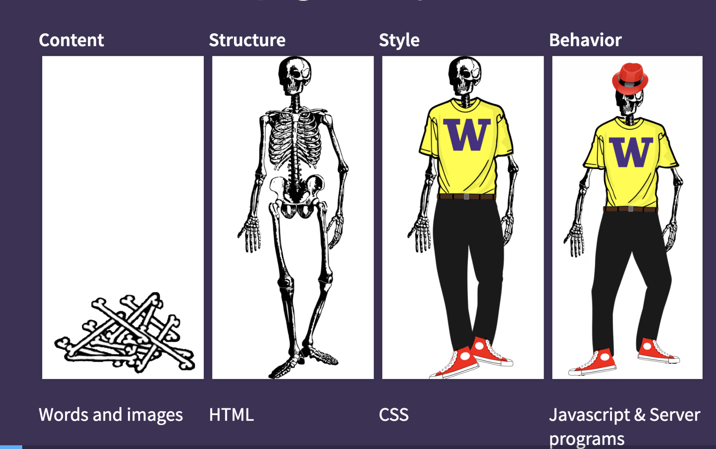
What is a web page, really?

Slide 17
Web Languages/Technologies Big list of different things
Content: Hypertext Markup Language (HTML)
Style: Cascading Style Sheets (CSS)
Behavior: JavaScript and libraries for creating interactive web pages
Data representation and transfer: JavaScript Object Notation(JSON).
Dynamic web servers: Hypertext Process (PHP)
Enhanced data transfer: Asynchronous JavaScript and XML (Ajax)
Data Bases: Structured Query Language (SQL)
Notes:
One stack of web technologies.

Slide 18
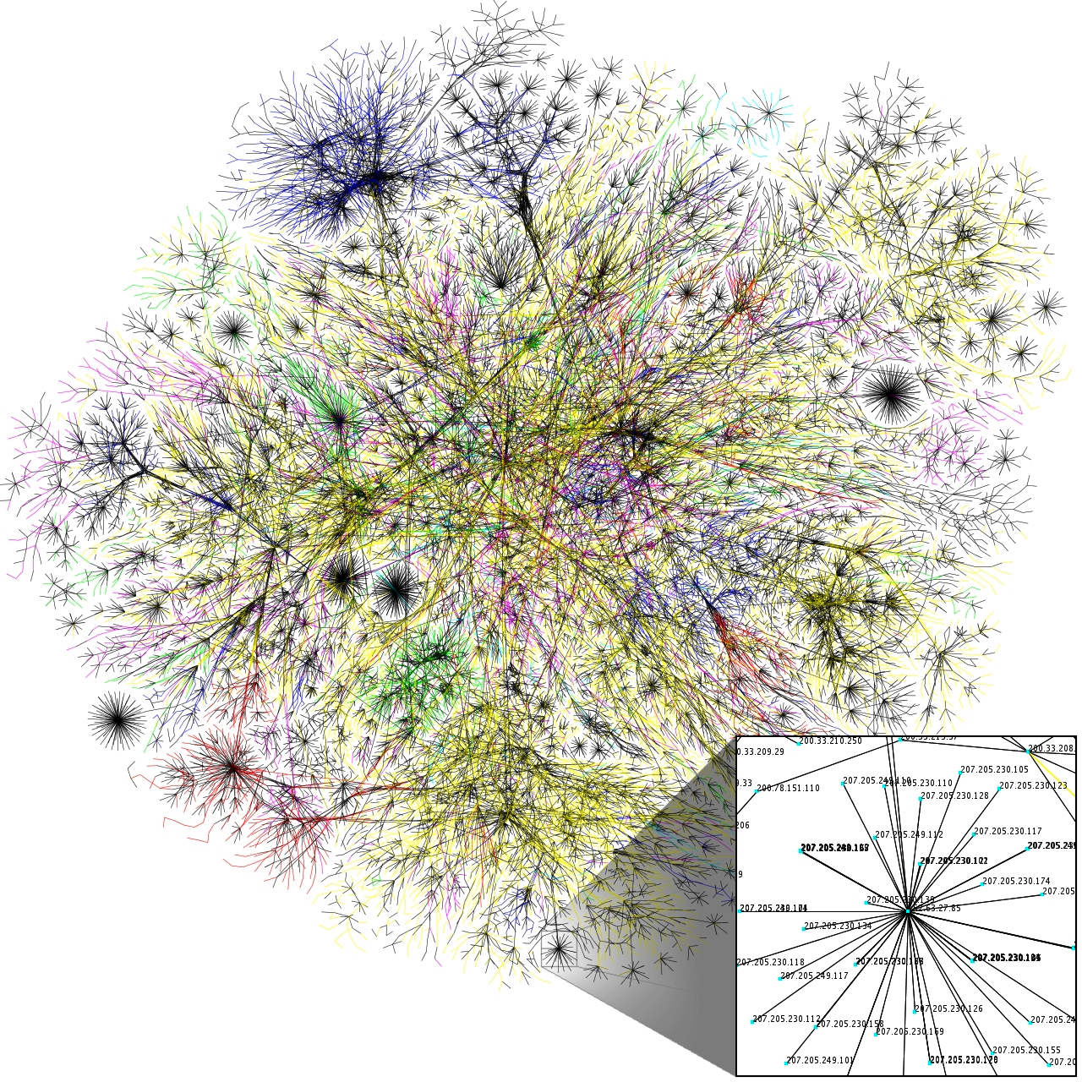
What is the internet?
http://en.wikipedia.org/wiki/Opte_Project
Notes:
Partial map of internet. Each line drawn between to nodes representing two IP addresses. The length of the lines represent delays. Purple is .com. Yellow is .net. Green is .gov

Slide 19
What is the internet?
The internet is a physical network connecting millions of computers using the same protocols (TCP/IP) of sharing transmitting information. In reality, internet is network of small networks.

Slide 20
The internet?
Wikipedia: https://en.wikipedia.org/wiki/Internet
A connection of computer networks the internet protocol (IP)
Layers of communication protocols: IP-> TCP/UDP-> HTTP/POP/FTP
What is the difference between Internet and the World Wide Web (WWW)?

Slide 21
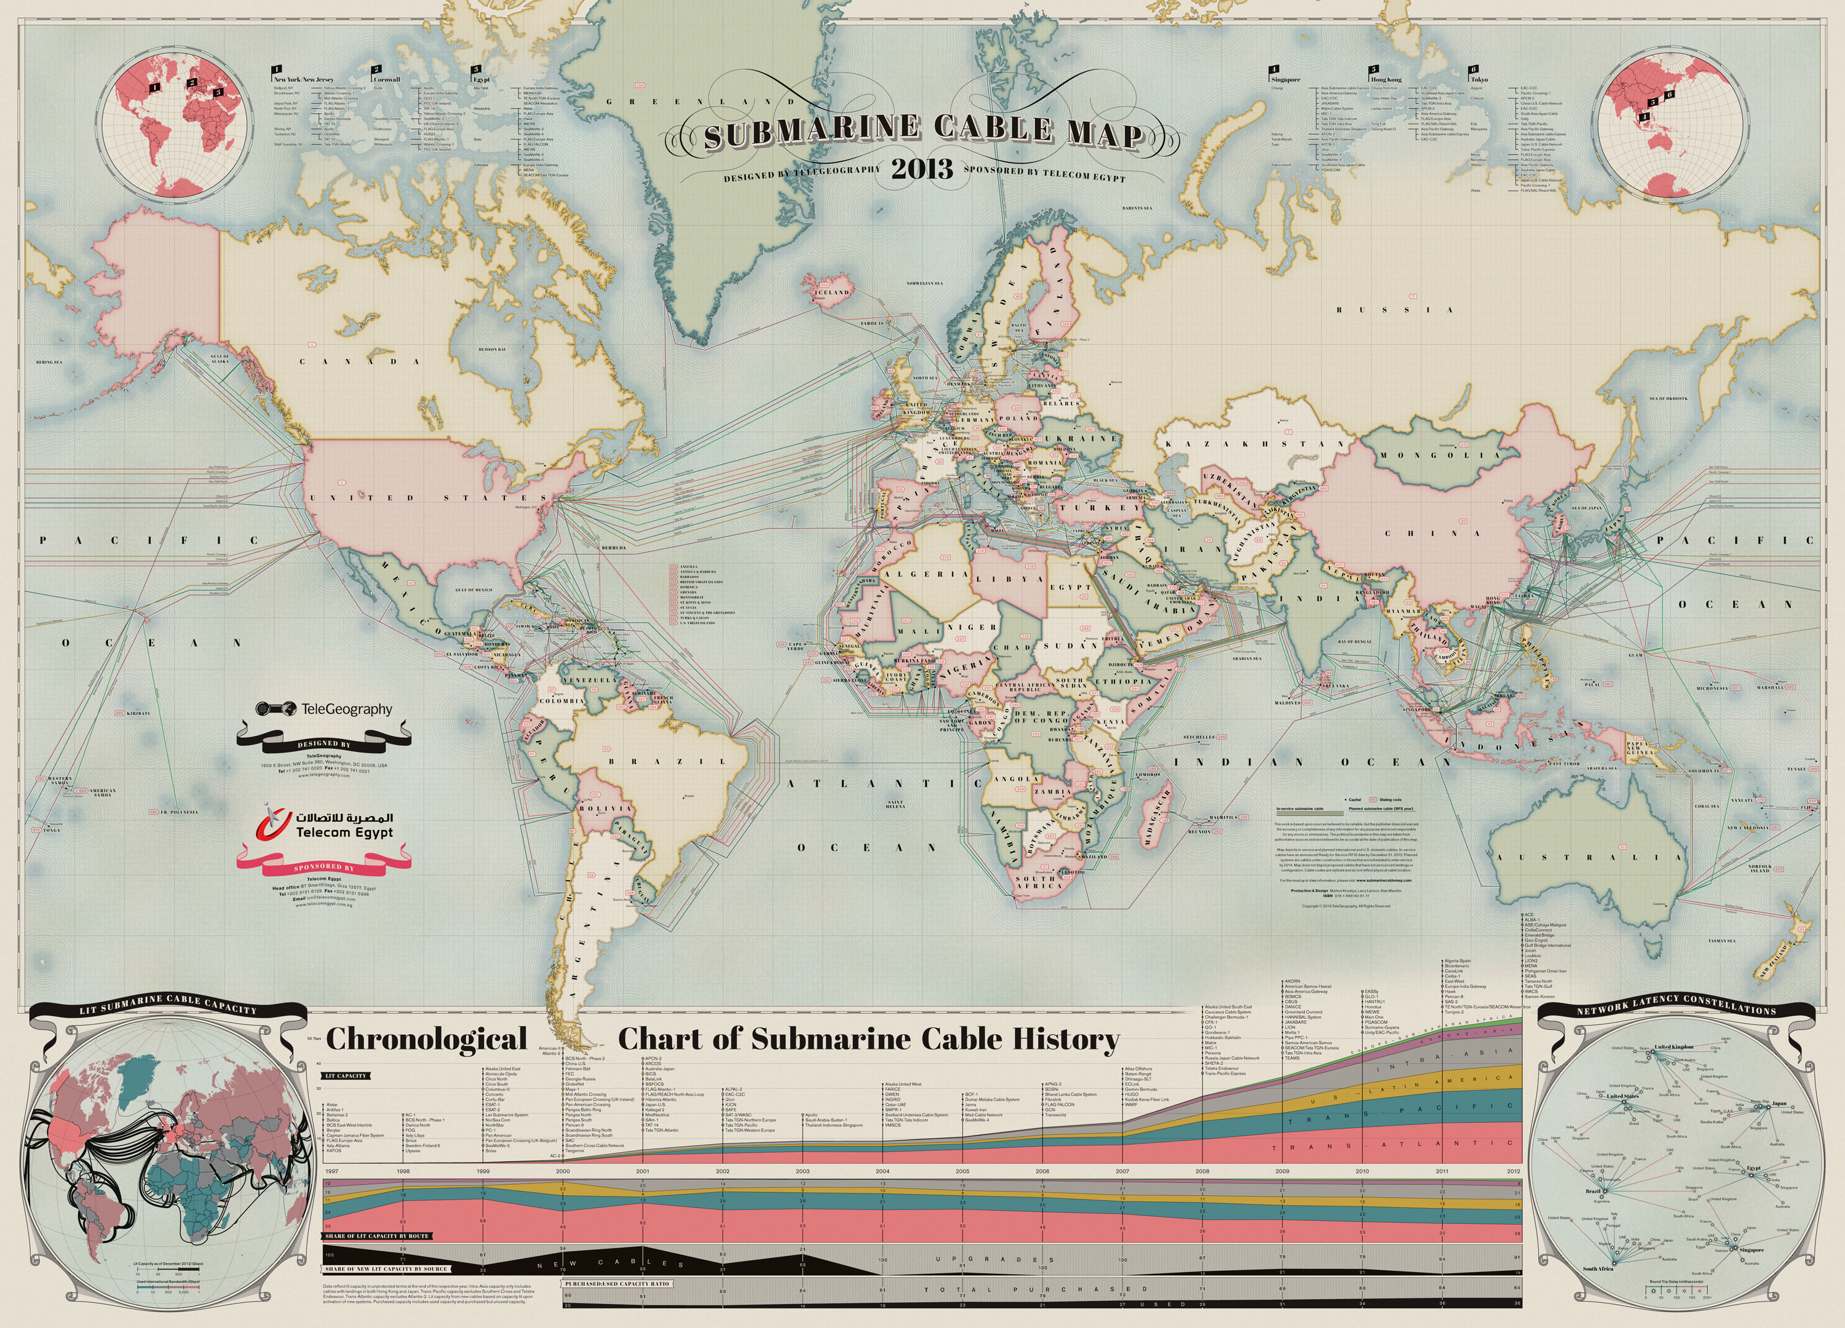
How is the internet connected?
http://www.telegeography.com/telecom-resources/map-gallery/submarine-cable-map-2013/

Slide 22
Brief history of the internet
Began as US Department of Defense network called APPANET (1960s-70s).
Initial services: electronic mail, file transfer through a computer
Opened to commercial interests in late 80s.
WWW created in 1989-91 by Tim Berners-Lee (2016 Turing Award)
Popular web browsers released: Netscape 1994, IE 1995, Mozzila 1998, Safari, 2003, Firefox, 2004, Chrome 2011.
Amazon.com opens in 1995; Google January 1999.
Facebook opened in 2004, Twitter in 2006.
Snapchat created in 2011.

Slide 23
Fun facts about the internet
1 out of 4 people have internet access.
The internet reaches 50 million users in 5 years.
More videos are uploaded to YouTube in the last 2 months than had ABC, NBC, and CBS all airing new content 24/7 since 1948.
There are 121,013,927 unique domains.
Most domains and pages are saved on servers and servers are saved on massive data centers.
Worldwide average internet speed incased to 7.2Mbps. Average speed has increased from 5.6Mbps in Q4 of 2015 to now. South Korea (28.6) retains 1st place for internet speed in 2017. United States (18.7).

Slide 24
Key Aspects of the Internet
Subnetworks can stand on their own
Computers can dynamically join and leave the network.
Built on open standards; anyone can create a new internet device.
Lack of centralized control (mostly)
Everyone can use it with simple, commonly available software.

Slide 25
Question
Who “runs” the internet? Who is responsible for overseeing it?

Slide 26
People and organizations
Internet Engineering Task Force (IETF):internet protocol standards
Internet Corporation for Assigned Names and Numbers (ICANN): decides top-level domain name.
World Wide Web consortium (W3C): web standards.
These protocols are carried out in large part by Internet service providers and other companies and organizations who build internet related projects and applications.

Slide 27
Layered Architecture
Physical layer: devices such as ethernet, coaxial cables, fiber-optical lines, modems
Data Link Layer: basic hardware protocols (ethernet, wifi, DSL PP).
Network/Internet Layer: basic software protocol (IP)
Transport layer: adds reliability to network layer (TCP, UDP)
Application layer: implements specific communications for each kind of program (HTTP, POP3/IMAP, SSH, FTP)

Slide 28
The World Wide Web (WWW)
World wide web: a collection of interlinked multimedia documents that are stored on the Internet and accessed using common HTTP and HTTPs protocols.
E.g. https://www.facebook.com/
How is it different from the Internet?
Notes:
Subsets of the internet using protocals called HTTP HTTPs

Slide 29
The World Wide Web
Web server: software that listens for web page requests
Apache
Microsoft Internet Information Server (IIS)(part of windows)
NGINX
Web Browsers: fetches/display documents from web server.
Mozilla Firefox
Microsoft IE and Microsoft Edge
Apple Safari
Google Chrome
Opera

Slide 30
What are other internet-based applications?
Email
Telnet
FTP
Instant messaging
File sharing
Data storage

Slide 31
Quiz
Is the internet the same as the web?

Slide 32
Quiz
Is the internet the same as the web?
If not, what is the key distinction?

Slide 33
Quiz
Is the internet the same as the web?
If not, what is the key distinction
Answer: Internet is hardware; web is software along with data.

Slide 34
Accessing a website
Type in a URL in an address bar in your browser: www.xkcd.com
“/” refers path of the server.
https://myau.american.edu/my.policy
AU60185:CSC435_WebProgramming bxiao$ Ping american.edu
PING american.edu (147.9.4.186): 56 data bytes
Request timeout for icmp_seq 0

Slide 35
Accessing a website
Type in a URL in an address bar in your browser: www.xkcd.com
Web server: a machine that stores all the content such as images and videos
xkcd
Client
Your Browser
Web server

Slide 36
Accessing a website
Computer communicate the server to tell which webpage you want to view
Server process the data and return the web content the browser needs
xkcd
Client
Your Browser
Web server

Slide 37
Accessing a website
How does the browser know which server contains contents of the website xkcd?
xkcd
Client
Your Browser
Web server

Slide 38
The Internet
xkcd
Client
Your Browser
Web server

Slide 39
Which server has the content of the requested website?
xkcd
Client
Your Browser
Web server

Slide 40
IP Address (which computer and where it is located)
xkcd
Client
Your Browser
Web server
IP: 72.26.203.99

Slide 41
IP (Internet Protocol) Address
The IP address give the location of the computer so that your computer can reach the server. Every computer at AU has the IP address from 147.
It contains 4 numbers, ranging from 1 to 255.
For more information, look at:Internet Protocal at wikipedia

Slide 42
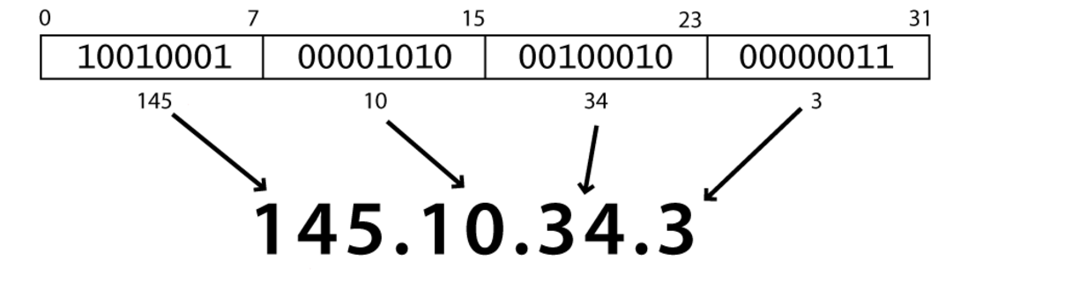
IPv4 (Internet Protocol)
A simple protocol for attempting to send data between two computers.
Each device has a 32-bit IP address written for four 8-bit numbers (0-255)
Find out your local IP address
In a terminal, type ipconfig(Windows) and ifconfig (Mac)
Find out your internet IP address: whatismyip.com

Slide 43
IP address versus URL
IP address: the actual address of a targeted web server.
URL refers to Uniform Resource Locator
URL: human-readable pseudonym for a web-server.
URL is mapped into an IP by a DNS server.

Slide 44
Question
Why don’t we directly type IP address into the browser?

Slide 45
Answer
URLs allow users to change their web server without remembering the IP address
Further reading:
Uniform Resource Locator (URL):
http://en.wikipedia.org/wiki/Uniform_resource_locator

Slide 46
URL
URL: Uniform Resource Locator
http://www.nytimes.com/pages/world/index.html
Query parameters
http://www.nytimes.com/pages/world/index.html?module=HPMiniNav&contentCollection=World&pgtype=Homepage&region=TopBar&action=click&t=qry69
Protocol
Host
Path

Slide 47
Question
You give the browser a URL, how does the browser know the IP address of the URL?

Slide 48
Question
How does your computer know the IP address when you give only the URL?
xkcd
Client
Your Browser
Web server
IP: 72.26.203.99

Slide 49
DNS (Domain Name System)
URL | IP
www.xkcd.com | 72.26.203.99
DNS server
Xkcd.com
72.26.203.99
xkcd
Client
Your Browser
Web server
IP: 72.26.203.99

Slide 50
HTTP Request
HTTP Request: GET www.xkcd.com
xkcd
Client
Your Browser
Web server
IP: 72.26.203.99

Slide 51
Hypertext Transport Protocol (HTTP)
The set of commands understood by a web server and sent from a browser
Some HTTP commands (your browser sends these internally):
GET filename: download
POST filename: send a web form request
PUT filename: upload

Slide 52
What is a HTTP Request?
HTTP: Hyper text Transfer Protocol
Your browser sends a request to the server:
Get me the file index.html
Read more here:
http://www.jmarshall.com/easy/http/#whatis
http://djce.org.uk/dumprequest

Slide 53
HTTP Response
HTTP Request: GET www.xkcd.com
xkcd
Client
Your Browser
HTTP Response: web content HTML file
Web server
IP: 72.26.203.99

Slide 54
HTTP Error code
Number | Meaning
200 | OK
301-303 | Page has moved
403 | You are forbidden to access this page
404 | Page not found
418 | I ‘m a teapot
500 | Internal server error
Complete List

Slide 55
Static versus Dynamic server-side processing
Static website: www.xkdc.com
Every user views the SAME page. So the content can be just saved on the server. In much the same way that your personal computer saves files on its hard drive.
Dynamic website: www.facebook.com
The specific content that a user sees the profile walls (which will change from time to time and from user to user) must be generated in real-time processing.
Notes:
The webserver must figure out who last posted on the wall.

Slide 56
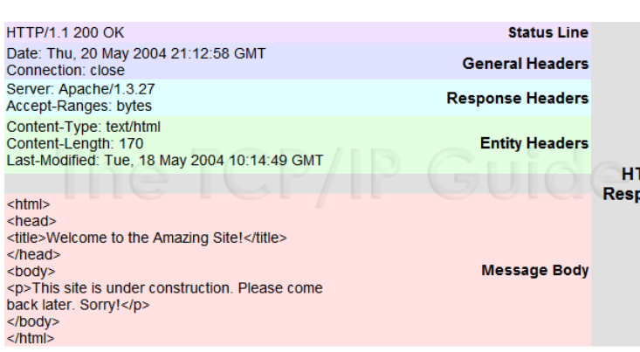
HTTP Response Format

Slide 57
Review
Browser map an URL into IP through DNS look up
Send a message to web server to request to view certain file: HTTP request
The webserver then do some server side processing and then send back the files back to the browser: HTTP responses. Fetch the files from a data server or generate the files on the fly.
The browser decide how to display the files on the webpages.

Slide 58
Internet Media (“MIME”) Types
Sometimes when including resources in a page(style sheet, icon, multimedia object), we specify their type of data
MIME type | File extension
Text/html | .html
Text/plain | .txt
Image/gif | .gif
Video/quicktime | .mov
List of MIME types by extension

Slide 59
Client-side technologies
The following types of files are kind that the server can send to your computer so your browser can render the web-page:
HTML
CSS
JavaScript

Slide 60
Client-side: HTML
HTML describes the content of a webpage
Headers
Text
Images and Videos
Hyperlinks

Slide 61
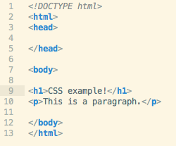
Client-side: HTML
HTML describes the content of a webpage

Slide 62
Client-side: CSS
Style HTML elements
Font-color
Background-color
Size
Positioning

Slide 63
Demo: a webpage with and without CSS

Slide 64
JavaScript
Adds Interactivity to web-pages
Submit forms
Button Presses
React to mouse movement
Change HTML content
Example: http://3d.xkcd.com/?teapot

Slide 65
Quiz
What type of files can be found on the web:
1. Music
2. Images
3. HTML
4. Plain texts
5. Videos

Slide 66
Server-side technology: e.g. Python CGI, PHP, Node.js
Used to run scripts on the server, in response to HTTP requests.
Collect form data
Generate dynamic page content
Handle user sessions and credentials
Interacts with databases

Slide 67
Server-side technology: Database
Database: an organized collection of data that
is maintained on the server
Account information and passwords
User-generated content (blog posts, comments, clicks on facebook, etc.)
MySQL is particular database that is commonly used with PHP.
Queries are requests to the database for information, e.g. last five comments on a blog.
MySQL process the queries.
Notes:
Eac

Slide 68
PHP and MySQL
Often work together
PHP make queries to MySQL
MySQL provides dynamic content
PHP uses the content to generate a dynamic webpage.
Notes:
Eac

Slide 69
Additional technologies
Python CGI: The Common Gateway Interface is a standard for external gateway programs to interface with information servers such as HTTP servers.
jQuery: JavaScript library. Very convenient syntax.
Ajax, a group of jQuery allows you to communicate with the server without loading the pages
Example: Microsoft bing search
Notes:
Eac

Slide 70
Review: Major pieces of the internet
HTTP
Your Computer + Browser
( Chrome,
Firefox,
IE)
The Internet
Servers
You

Slide 71
Example: online banking
A client access to a web browser (the client): www. bankofamerica.com
The login credentials are stored in the database
The web server access the database server (e.g. MySQL)
The database server might fetch financial transaction records from another database server.
An application server interprets the returned data by following the bank’s business logic and return to the web server.
The web server sends the result back to the browser, which interprets the data.
Checking account balance:
HTTP reply
Data client
HTTP request
Web server
of the bank
Database (account info)
Client Browser

Slide 72
We will learn
Before Mid-term
HTML
CSS
JavaScript
After Mid-term
PythonCGI
PHP
MySQL
Ajax (if time allows)
Web frameworks

Slide 73
Quiz
Which of the following process the request to return web content:
A DNS server
A Web server
Your browser
A particular web server
All of above

Slide 74
Answer
Which of the following process the request to return web content:
A DNS server
A Web server
Your browser
A particular web server
All of above

Slide 75
Homework
Install one of the following editors:
http://brackets.io
Create an account and repository at GitHub and learn Git:
https://github.com
https://guides.github.com/introduction/git-handbook/
Please read about HTTP:
http://www.jmarshall.com/easy/http/#whatis

Slide 76
Further Readings
URL: http://en.wikipedia.org/wiki/Uniform_resource_locator
HTTP Request:
http://djce.org.uk/dumprequest
HTTP Response:
http://www.tcpipguide.com/free/t_HTTPResponseMessageFormat.htm

Slide 77
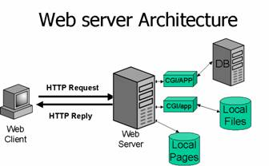
Client-Server Architecture
http://www2.sans.org/security-resources/malwarefaq/guestbook.php

Slide 78
URL
URL: Uniform Resource Locator
http://www.nytimes.com/pages/world/index.html
Query parameters
http://www.nytimes.com/pages/world/index.html?module=HPMiniNav&contentCollection=World&pgtype=Homepage&region=TopBar&action=click&t=qry69
Protocol
Host
Path

Slide 79
Quiz
Given the following URL, identify different components of the URL
http://www.lumosity.com/landing_pages/431?gclid=CI2Wntii8LsCFUpnOgodR1UA5A
Protocol
Host
Path
Query

Slide 80
Quiz
Given the protocol https, the host www.washingtonpost.com, the path /politics/
What is the URL?

Slide 81
HTTP: how browser talks to the server
HyperText Transfer Protocol
HTTP Request methods: Post and Get
Get: get a document from the server
http://www.example.com/foo
Get/ foo HTTP/1.1
Method, Path, Version

Slide 82
HTTP: Get method
Example: Amazon search for French Press returns the following URL. What is the request line to GET this URL using HTTP/1.1?
http://www.amazon.com/s/ref=nb_sb_noss_2?url=search-alias%3Daps&field-keywords=frensh%20press
Notes:
Get (method) s/ref=nb_sb_noss_2?url=search-alias%3Daps&field-keywords=frensh%20press HTTP 1.1

Slide 83
HTTP Responses
Example: Amazon search for French Press returns the following URL. What is the request line to GET this URL using HTTP/1.1?
http://www.amazon.com/s/ref=nb_sb_noss_2?url=search-alias%3Daps&field-keywords=frensh%20press
Notes:
Get (method) s/ref=nb_sb_noss_2?url=search-alias%3Daps&field-keywords=frensh%20press HTTP 1.1

